Slide 1
DATA-CAN PPIE Meeting
“From consultation to dataset”
PART 1 – Data to manage your care
“Real-time data”

Slide 2
The journey of data – from consultation to dataset
This is based on a generic set of circumstances and events, and is in no way reflective of any individual here or elsewhere
What this session tries to demonstrate is how data about you is generated, where and by who. And in particular, what does it look like, and what happens to it once it has been created?
The subject is much too big to cover in detail, so be prepared to ask questions, and make suggestions…..
(And don’t forget, you are the guinea pigs for this)

Slide 3
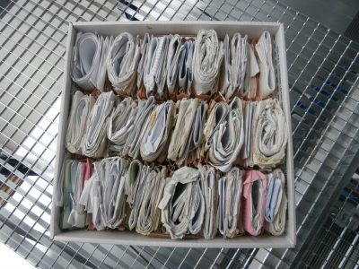
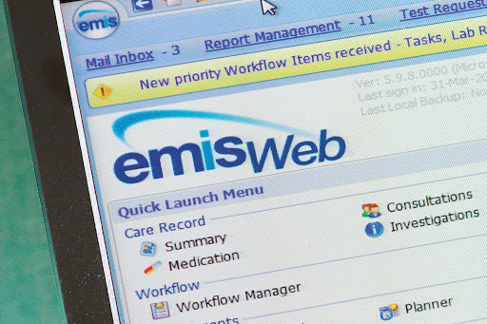
The start of your data journey
Logon to your GP Practice system, and make an appointment
Or give them a call, and ask for an appointment
Or go through an online intermediary (e.g. Doctorlink)
If you are registered with a Practice, they will already have your details on their Practice Computer system

Slide 4


What is in your GP record?
Contact details
Height and weight
Allergies, for example to a medicine like penicillin or to pollen if you have hay fever
Vaccinations and immunisations, for example tetanus and polio
Examinations and screening
Medicines
Illnesses or diagnoses
Operations
Test results, such as blood and urine tests, peak flow readings for breathing difficulties
X-rays and scans
Notes about your appointments with doctors and nurses at your surgery
Letters from hospitals, community nurses, such as district nurses, podiatrists and other medical staff that look after you
Lifestyle information, for example whether you smoke and drink alcohol or not, or how much you exercise

Slide 5


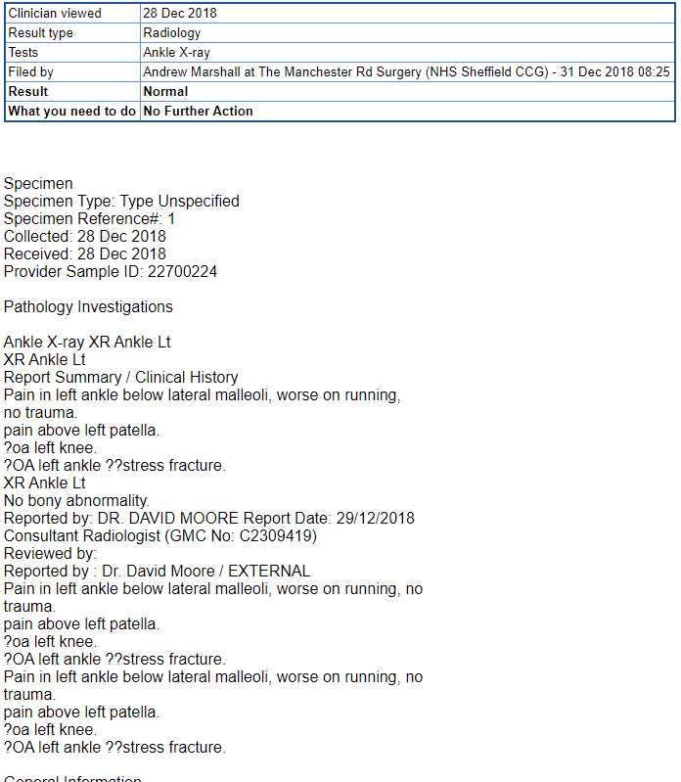
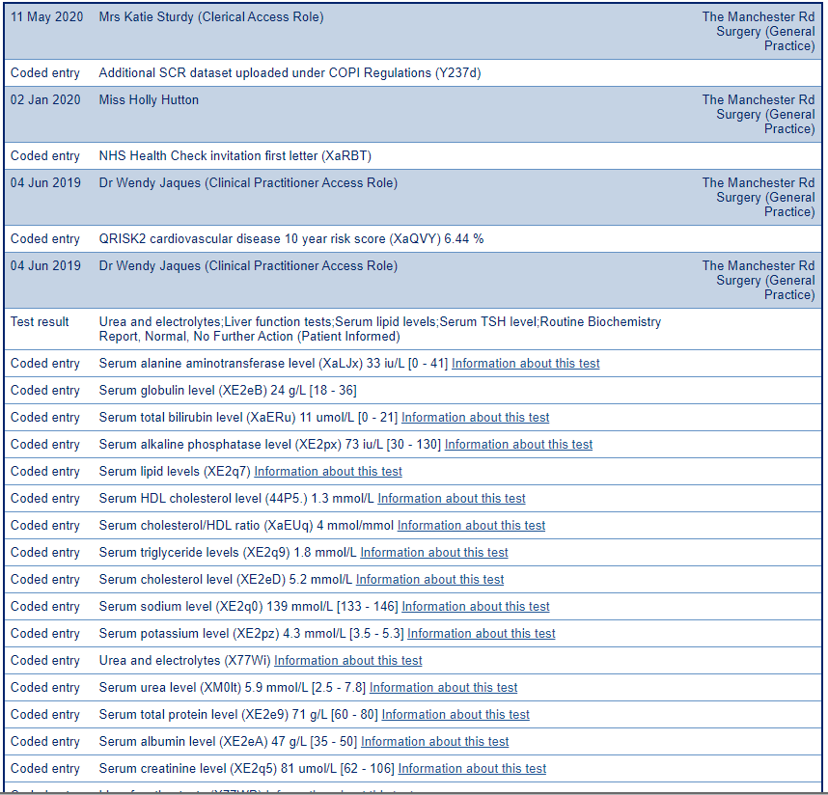
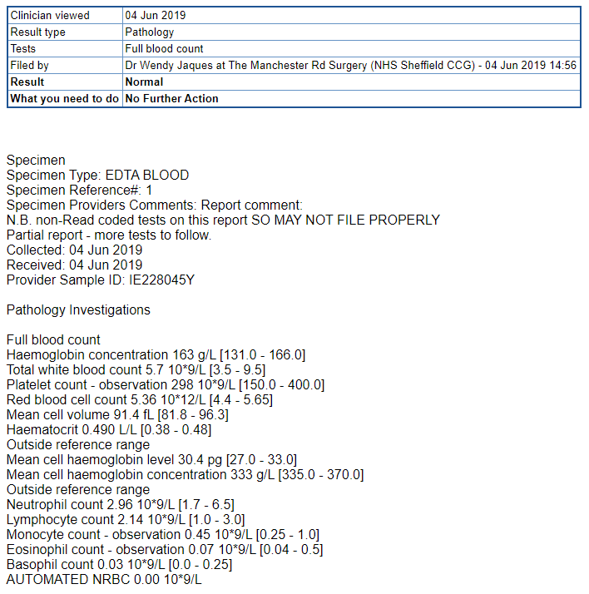
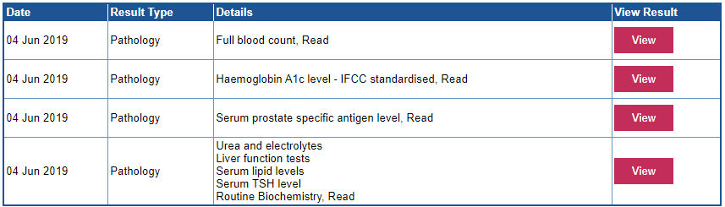
Notes:
You can look at your GP record yourself – here is mine
Here we see an initial list of tests , and you can look at particular one
Here I’m looking at some tests done on 4 June 2019
The data comes directly from laboratory systems, straight back into the GP system
If we look at just one of these lines, you begin to see the detailed information
An I wanted to show you a slightly different test result. This is from an X-ray that I had in December 2018

Slide 6
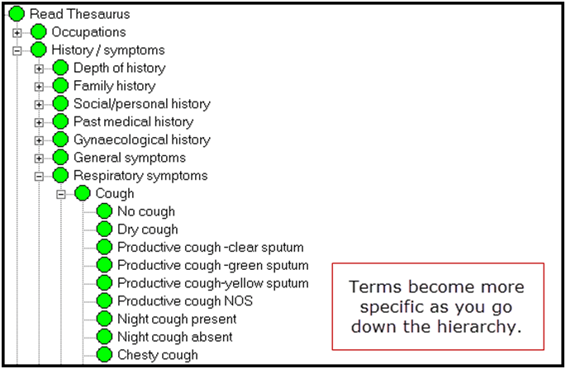
How your GP records information
What it looks like……
Notes:
Contrast this with the lab results you’ve just seen…..
These are READ codes

Slide 7
I have a lump. I’ll see my GP.
Go to your GP
Get a referral
Go to a hospital appointment
Have some tests, path, radiol
Go home
Get another letter/call
Go back in for the results
Get a diagnosis
Get some treatments options (incl trials)
Observations (often using a device)
Think
Start treats
Iterative
Wait
Check-ups

Slide 8
The referral from your GP to the hospital
Electronic communication (from the Practice System to the hospital system)
Phone call
Letter / Secure email
The request details sit on both the GP and the hospital system
The hospital creates an appointment for you; date, time, clinic, instructions**
“Structured data”
“Unstructured data”

Slide 9
Your hospital appointment
“What’s your name, address and date of birth?”
(not for the first time)
The hospital records (or checks) your details, and records you as attending

Slide 10
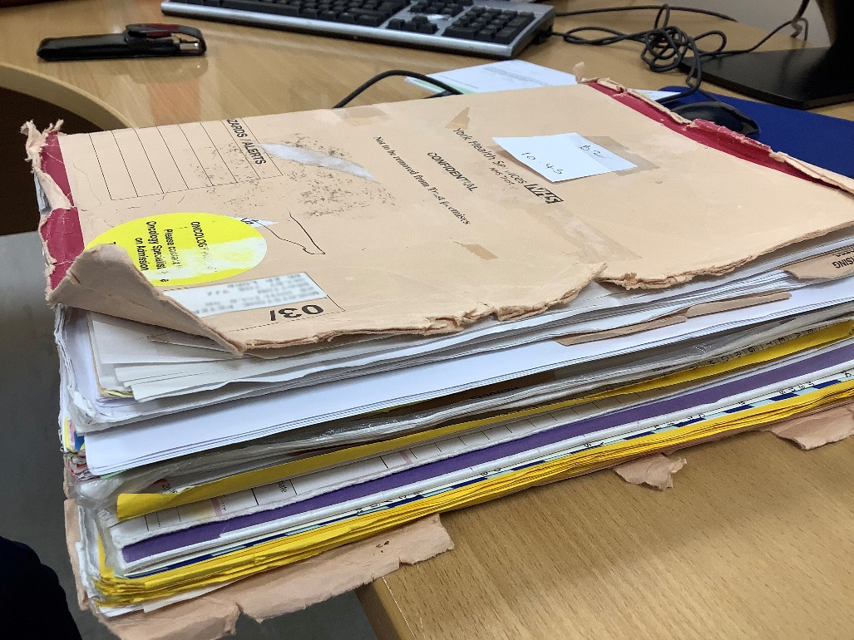

Your hospital record…….

Slide 11
Your hospital record…….
Hand-written notes are typed-up by medical secretary or hospital medical records staff, into your electronic hospital record
In some hospitals, your attendance, lab results, radiology and pathology results are on the same system. In others, they are on separate systems, and the main hospital system holds summary details of the test results
Images (e.g. X-rays) are held on separate systems, but can be viewed by the clinical teams

Slide 12
Your hospital record…….
Your electronic data is largely held in codes
But there is still a large amount of free-text
Text is easier to read
Codes are easier to analyse, but
  There are several different coding systems
  Disease classifications
  Clinical procedures
  Treatments
What, where, how, how much

Slide 13
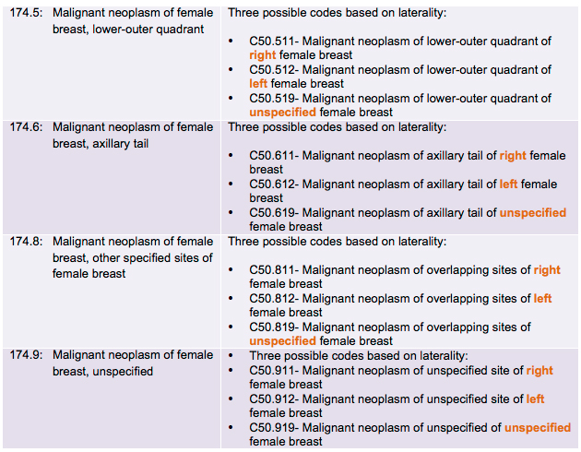
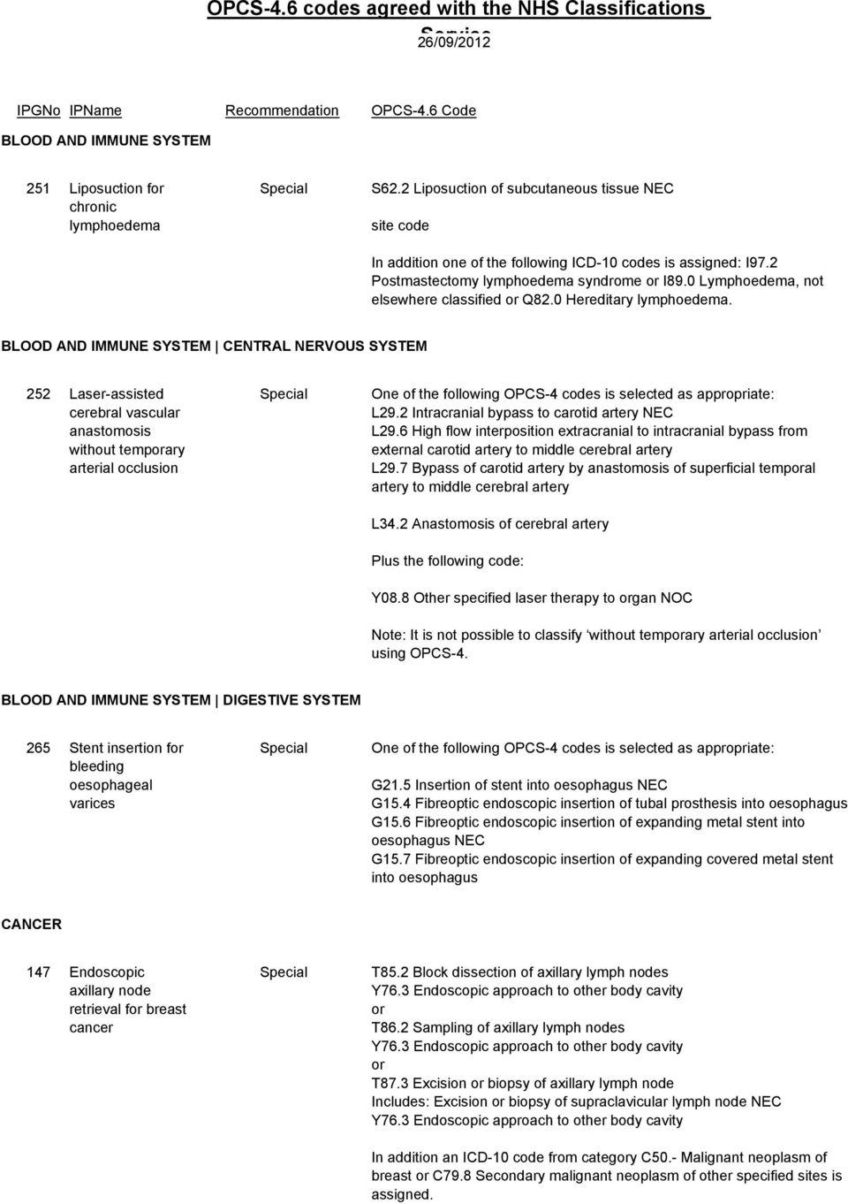
Here is a hospital record…….
Your data is largely held in codes
But there is a lot of free-text
Text is easier to read
Codes are easier to analyse, but
There are several different coding systems
Disease classifications
Clinical procedures
Treatments
What, where, how, how much

Slide 14
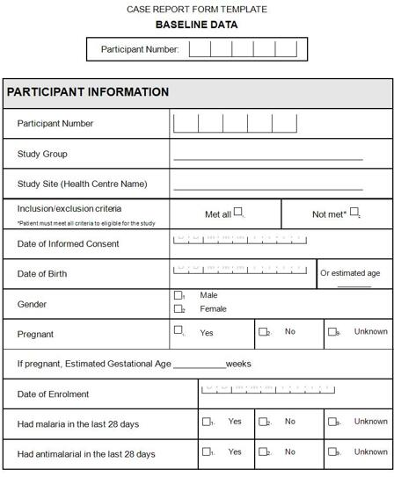
If you are on a clinical trial….

Slide 15
Questions?
What were you asked, about your data?
Did you get asked for consent?
Did you see any information about your data?
The “best time to ask”….

Slide 16
END OF PART 1

